Slide 1

External Format Processing
Parsing JSON, JSON.NET
SoftUni Team
Technical Trainers
Software University
https://about.softuni.bg/

Slide 2
Table of Contents
JSON Data Format
Processing JSON
System.Text.Json
JSON.NET
Configuring JSON.NET
LINQ-to-JSON
XML-to-JSON
2

Slide 3
Have a Question?
sli.do
#csharp-db

Slide 4
JSON Data Format
{JSON}
Definition and Syntax

Slide 5
JSON Data Format
JSON (JavaScript Object Notation) is a lightweight data format
Human and machine-readable plain text
Based on JavaScript objects
Independent of development platforms and languages
JSON data consists of:
Values (strings, numbers, etc.)
Key-value pairs: { key : value }
Arrays: [value1, value2, …]
{
"firstName": "Pesho",
"courses": ["C#", "JS", "ASP.NET"]
"age": 23,
"hasDriverLicense": true,
"date": "2012-04-23T18:25:43.511Z",
// ...
}

Slide 6
JSON Data Format (2)
The JSON data format follows the rules of object creation in JS
Strings, numbers and Booleans are valid JSON:
Arrays are valid JSON:
Objects are valid JSON (key-value pairs):
"this is a string and is valid JSON"
3.14
true
[5, "text", true]
{
"firstName": "Svetlin", "lastName": "Nakov",
"jobTitle": "Technical Trainer", "age": 40
}

Slide 7
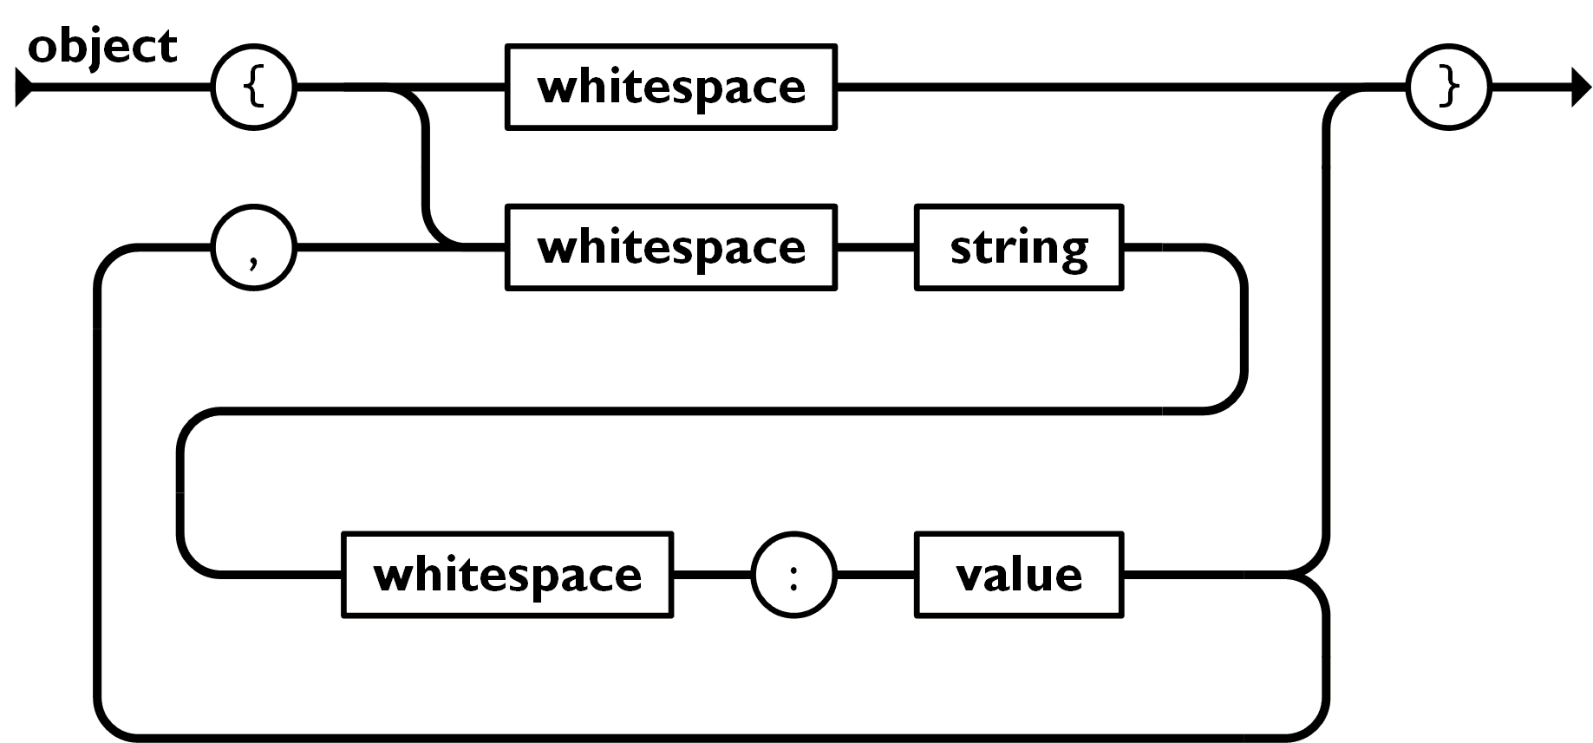
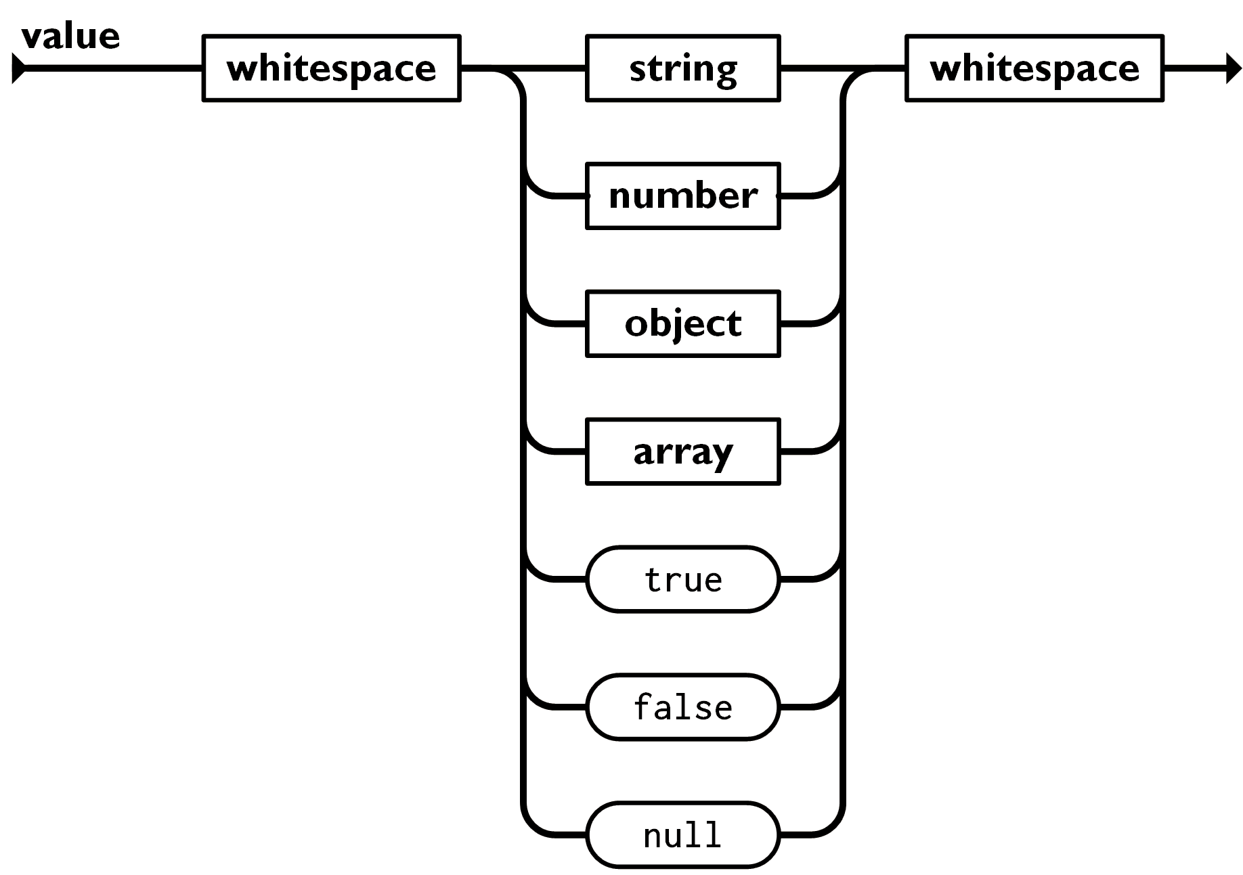

Object, Array and Value in JSON

Slide 8

Processing JSON
{JSON}
Parsing JSON in C# and .NET with System.Text.Json

Slide 9
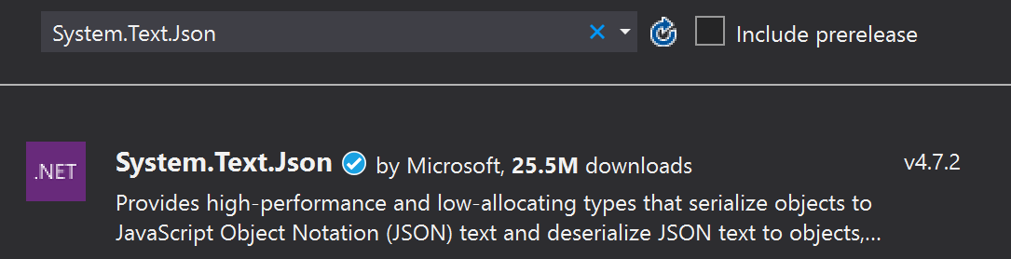
Built-in JSON Support
.NET has built-in JSON support through the System.Text.Json NuGet Package
It supports serializing objects and deserializing (parsing) strings
Include the following namespaces into your project:
using System.Text.Json;
using System.Text.Json.Serialization;
9

Slide 10
Serializing JSON
The System.Text.Json serializer can read and write JSON
class WeatherForecast
{
public DateTime Date { get; set; } = DateTime.Now;
public int TemperatureC { get; set; } = 30;
public string Summary { get; set; } = "Hot summer day";
}
static void Main()
{
WeatherForecast forecast = new WeatherForecast();
string weatherInfo = JsonSerializer.Serialize(forecast);
Console.WriteLine(weatherInfo);
}

Slide 11
Serializing JSON (2)
Creating a JSON file
static void Main()
{
WeatherForecast forecast = new WeatherForecast();
string weatherInfo = JsonSerializer.Serialize(forecast);
File.WriteAllText(file, weatherInfo);
}
{"Date":"2020-07-16T13:33:25","TemperatureC":30,"Summary":"Hot summer day"}

Slide 12
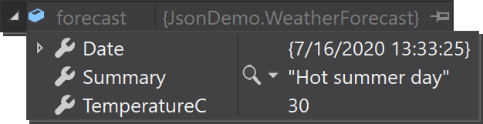
Deserializing JSON
To deserialize from a file, we read the file into a string and then use the Deserialize method
static void Main()
{
string jsonString = File.ReadAllText(file);
WeatherForecast forecast = JsonSerializer.Deserialize<WeatherForecast>(jsonString);
}

Slide 13
JSON.NET
Newtonsoft
Json.NET
Better JSON Parsing for .NET Developers

Slide 14
What is JSON.NET?
JSON.NET is a JSON framework for .NET
More functionality than built-in functionality
Supports LINQ-to-JSON
Out-of-the-box support for parsing between JSON and XML
Open-source project: http://www.newtonsoft.com
Newtonsoft.Json vs System.Text.Json
Performance comparison
Table of differences

Slide 15
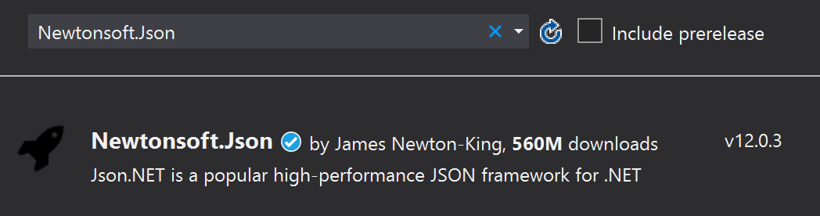
Installing JSON.NET
To install JSON.NET use the NuGet Package Manager:
Or with a command in the Package Manager Console:
Install-Package Newtonsoft.Json

Slide 16
General Usage
JSON.NET exposes a static service JsonConvert
Used for parsing and configuration
To Serialize an object:
To Deserialize an object:
var jsonProduct = JsonConvert.SerializeObject(product);
var objProduct =
JsonConvert.DeserializeObject<Product>(jsonProduct);

Slide 17
JSON.NET Features
JSON.NET can be configured to:
Indent the output JSON string
To convert JSON to anonymous types
To control the casing and properties to parse
To skip errors
JSON.NET also supports:
LINQ-to-JSON
Direct parsing between XML and JSON

Slide 18
Configuring JSON.NET
By default, the result is a single line of text
To indent the output string use Formatting.Indented
JsonConvert.SerializeObject(products, Formatting.Indented);
{
"pump": {
"Id": 0,
"Name": "Oil Pump",
"Description": null,
"Cost": 25.0
},
"filter": {
"Id": 0,
"Name": "Oil Filter",
"Description": null,
"Cost": 15.0
}
}

Slide 19
Configuring JSON.NET
Deserializing to anonymous types:
Incoming JSON
var json = @"{ 'firstName': 'Svetlin',
'lastName': 'Nakov',
'jobTitle': 'Technical Trainer' }";
var template = new
{
FirstName = string.Empty,
LastName = string.Empty,
JobTitle = string.Empty
};
var person = JsonConvert.DeserializeAnonymousType(json, template);
Template objects

Slide 20
JSON.NET Attributes
By default JSON.NET takes each property / field from the class and parses it
This can be controlled using attributes:
public class User
{
[JsonProperty("user")]
public string Username { get; set; }
[JsonIgnore]
public string Password { get; set; }
}
Parse Username to user
Skip the property

Slide 21
JSON.NET Parsing of Objects
By default JSON.NET takes each property / field from the class and parses it
This can be controlled using ContractResolver:
DefaultContractResolver contractResolver =
new DefaultContractResolver()
{
NamingStrategy = new SnakeCaseNamingStrategy()
};
var serialized = JsonConvert.SerializeObject(person,
new JsonSerializerSettings()
{
ContractResolver = contractResolver,
Formatting = Formatting.Indented
});

Slide 22
LINQ-to-JSON (1)
LINQ-to-JSON works with JObjects
Create from JSON string:
Reading from file:
Using JObject:
JObject obj = JObject.Parse(jsonProduct);
var people = JObject.Parse(File.ReadAllText(@"c:\people.json"))
foreach (JToken person in people)
{
Console.WriteLine(person["FirstName"]); // Ivan
Console.WriteLine(person["LastName"]); // Petrov
}

Slide 23
LINQ-to-JSON (2)
JObjects can be queried with LINQ
var json = JObject.Parse(@"{'products': [
{'name': 'Fruits', 'products': ['apple', 'banana']},
{'name': 'Vegetables', 'products': ['cucumber']}]}");
var products = json["products"].Select(t =>
string.Format("{0} ({1})",
t["name"],
string.Join(", ", c["products"])
))
// Fruits (apple, banana)
// Vegetables (cucumber)

Slide 24
XML-to-JSON
{
"?xml": {
"@version": "1.0",
"@standalone": "no"
},
"root": {
"person": [
{
"@id": "1",
"name": "Alan",
"url": "www.google.com"
},
{
"@id": "2",
"name": "Louis",
"url": "www.yahoo.com"
}
]
}
}
string xml = @"<?xml version='1.0' standalone='no'?>
<root>
<person id='1'>
<name>Alan</name>
<url>www.google.com</url>
</person>
<person id='2'>
<name>Louis</name>
<url>www.yahoo.com</url>
</person>
</root>";
XmlDocument doc = new XmlDocument();
doc.LoadXml(xml);
string jsonText = JsonConvert.SerializeXmlNode(doc);

Slide 25

Summary
…
…
…
JSON is a cross platform text-based data format
System.Text.Json is the JSON Parser in C#
JSON.NET is a fast framework for working with JSON data

Slide 26
Questions?
Notes:
26

Slide 27












SoftUni Diamond Partners

Slide 28


Educational Partners

Slide 29
Trainings @ Software University (SoftUni)
Software University – High-Quality Education, Profession and Job for Software Developers
softuni.bg, about.softuni.bg
Software University Foundation
softuni.foundation
Software University @ Facebook
facebook.com/SoftwareUniversity
Software University Forums
forum.softuni.bg
29
Notes:
29

Slide 30

License
This course (slides, examples, demos, exercises, homework, documents, videos and other assets) is copyrighted content
Unauthorized copy, reproduction or use is illegal
© SoftUni – https://about.softuni.bg
© Software University – https://softuni.bg
Notes:
30

